Slide 1






Data Science in Context Firebase and R with fireData
And others!
How to be an (R)admin and a full stack R developer
Preston Peck Mobile Developer DATA 607 11/10/21

Slide 2

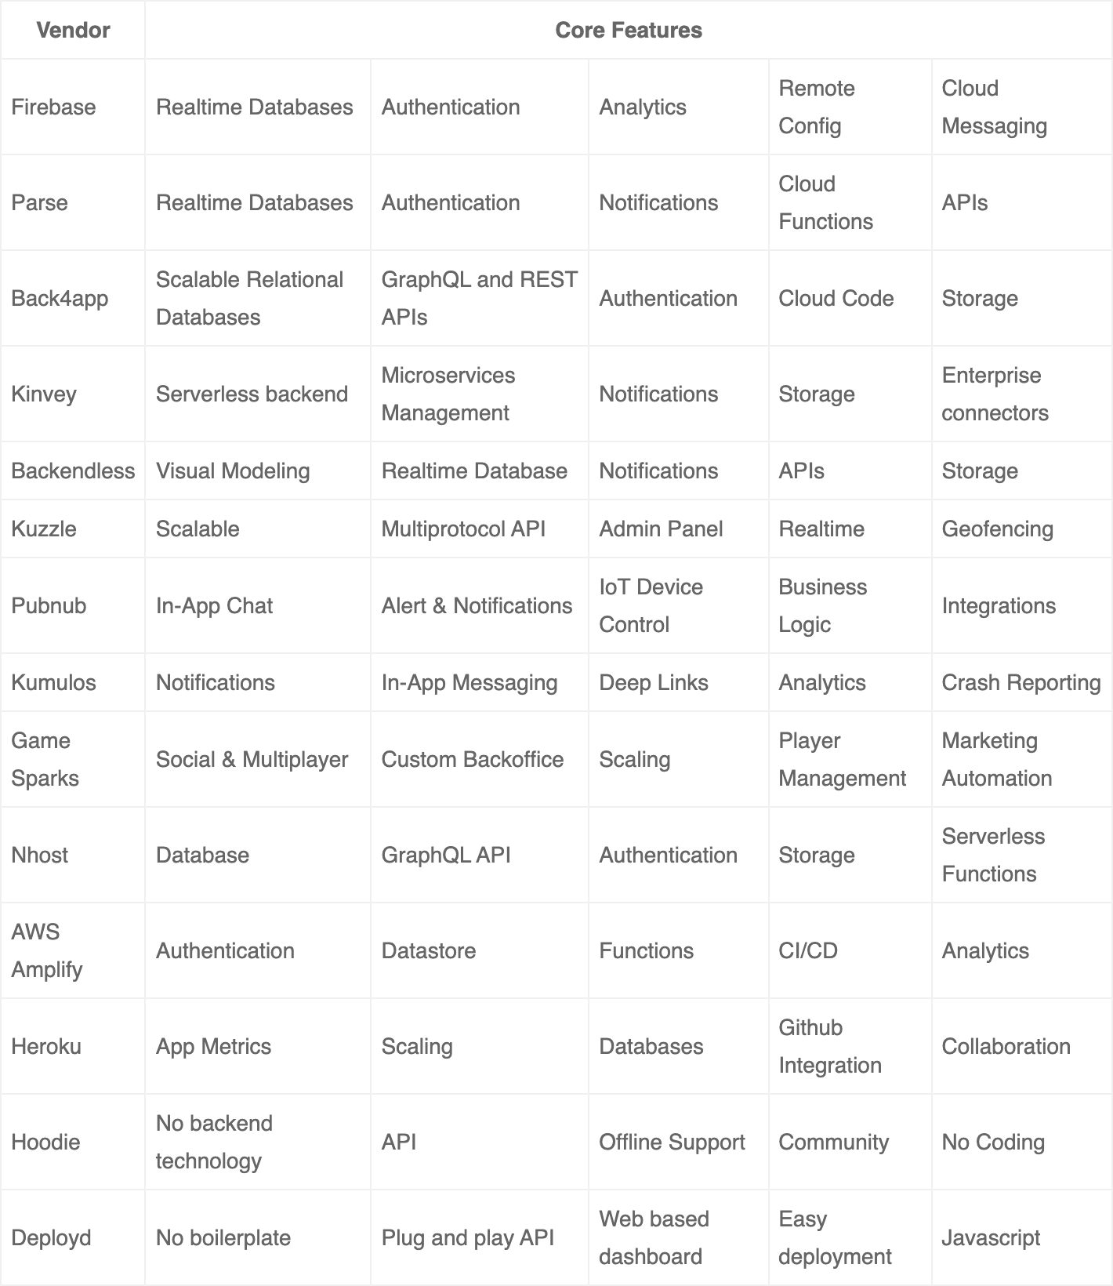



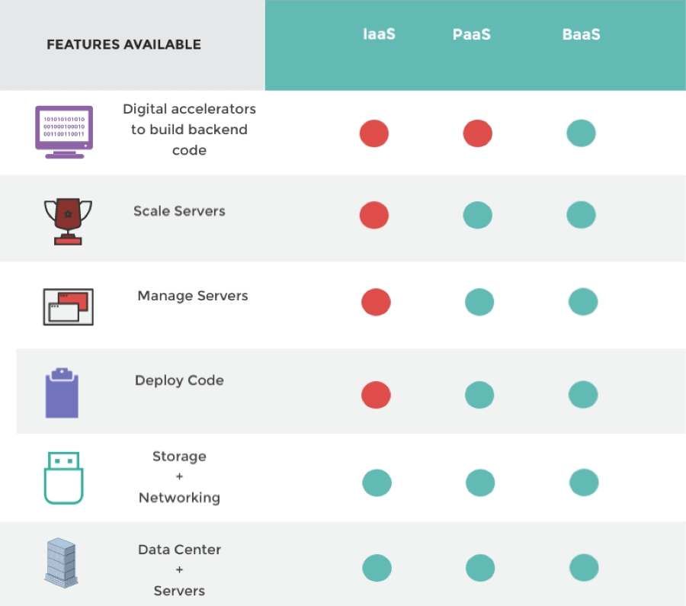




(M)BaaS
(Mobile) Backend as a Service — many support Web
Fast, cheap, and convenient
$2B in 2020 to $6B in 2025
Can be Cloud, Dedicated Servers, or On-Premises
Infrastructure
Platform
Backend

Slide 3

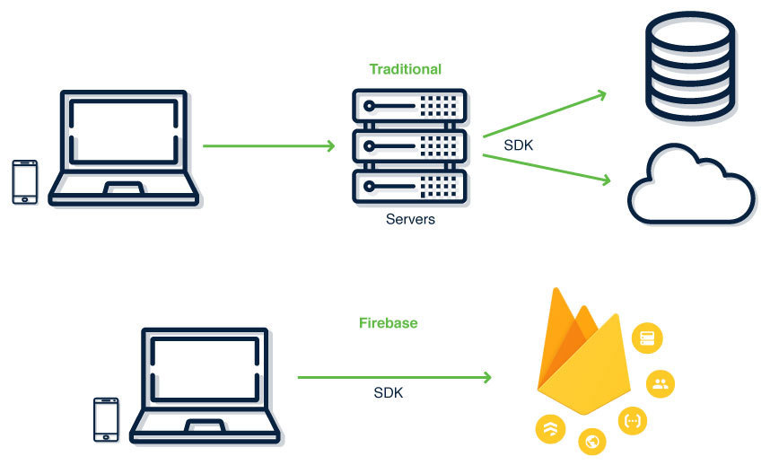


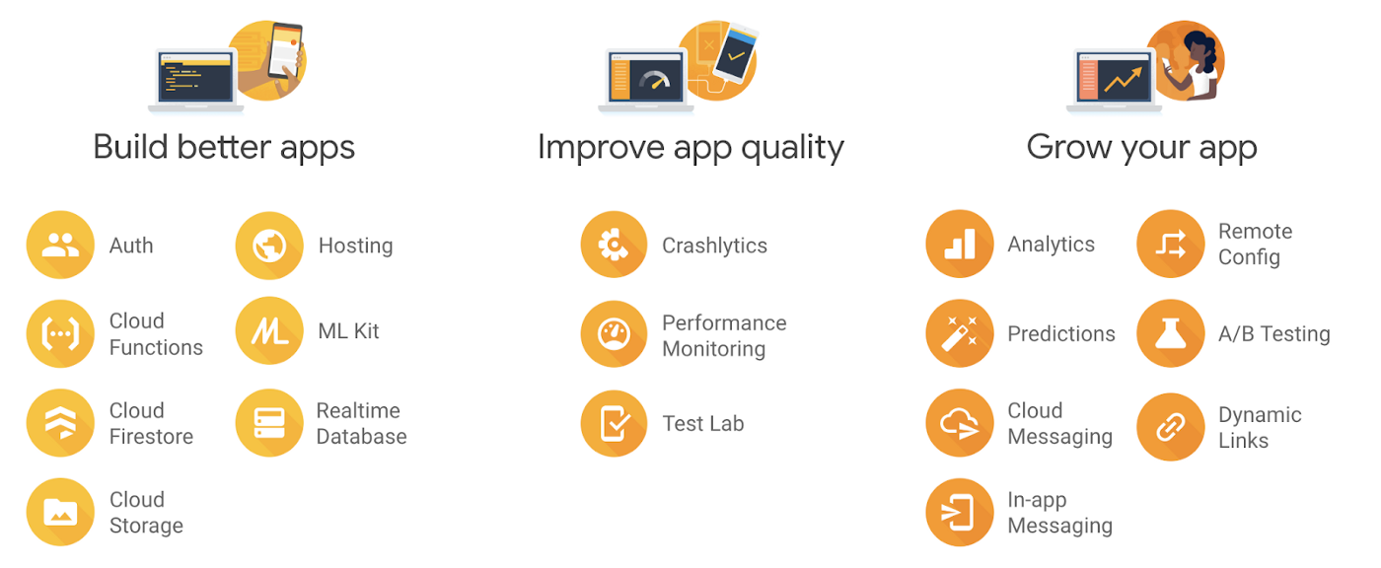


Google Firebase
Founded ‘11 — Acquired ‘14
Backed by Google Cloud Platform (GCP)
Supports iOS, Android, Web, Unity, and C++
Integrates with BigQuery, GAds, GAnalytics
Free Spark plan, Pay-as-You-Go Blaze plan

Slide 4

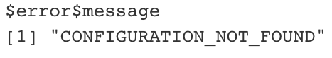
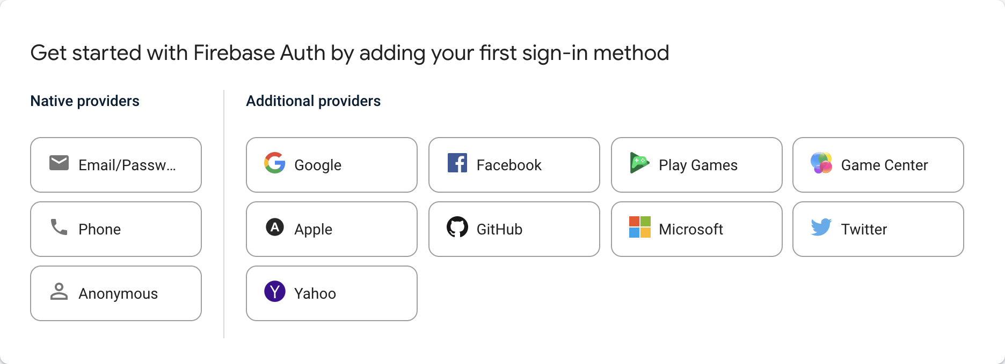
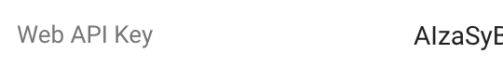
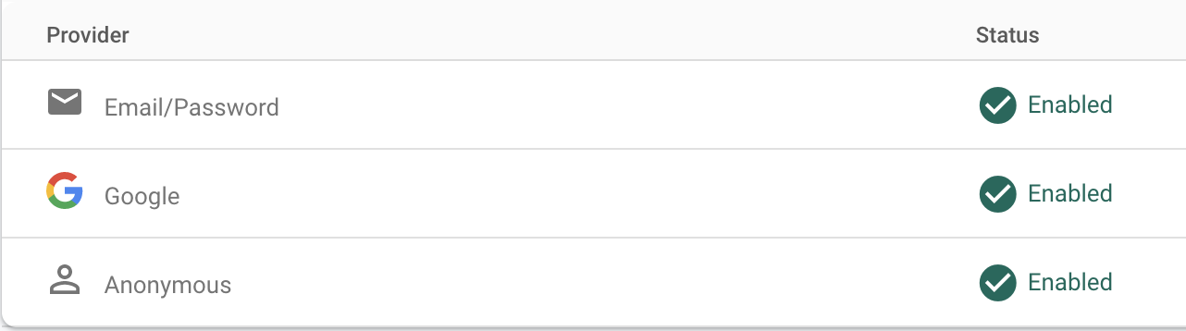
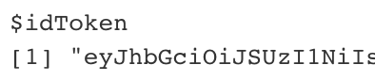

FireData — Authentication (CLI)
by Robin Kohze — Anonymous — Google — Email
Activate providers
Project Settings > General > Web API Key
Call login (API key)
anonymous_login
google_login (requires GCP client id & secret)
createUser (email)
o_auth_login
auth
resetPassword

Slide 5
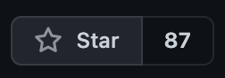
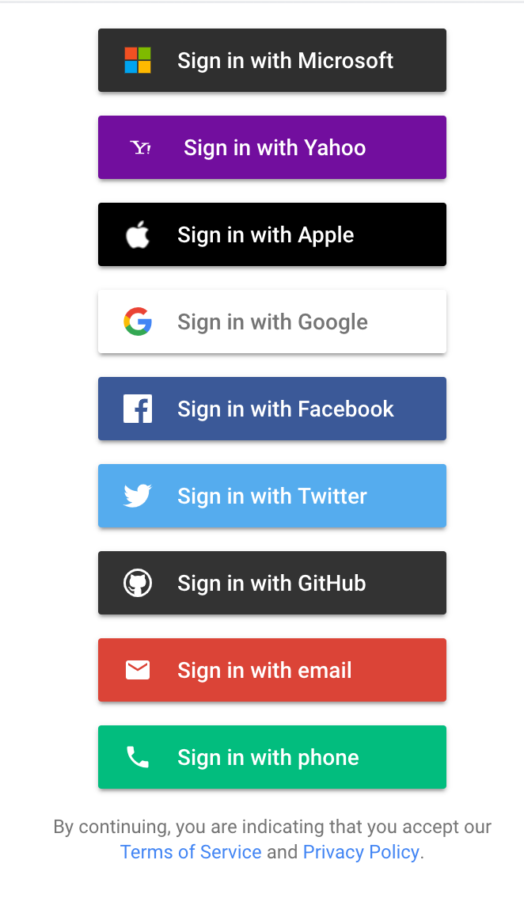
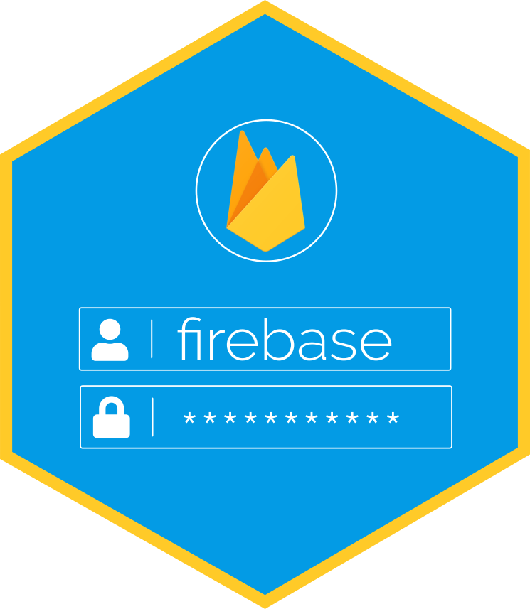
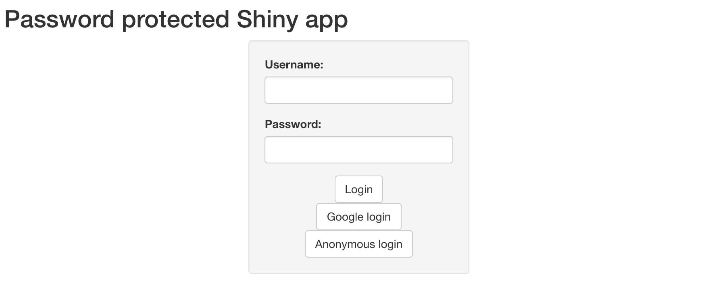
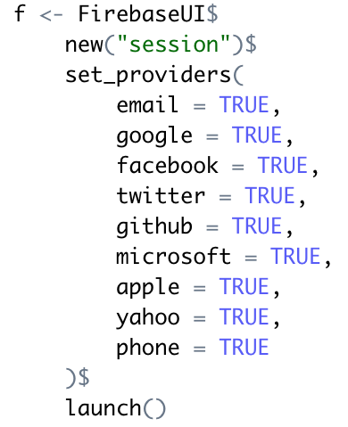
Firebase — Authentication (Shiny)
FireData — Firebase by John Ceone
shiny_auth_server
FirebaseUI$set_providers

Slide 6



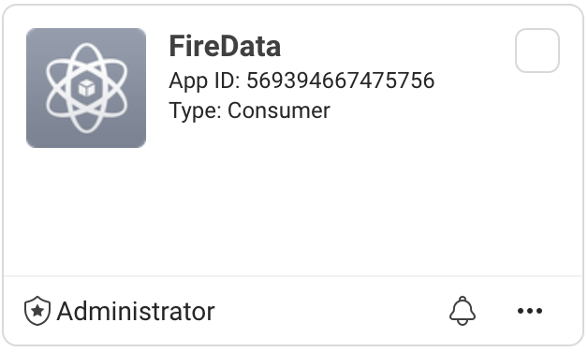


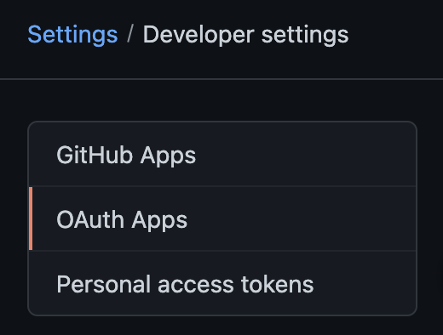



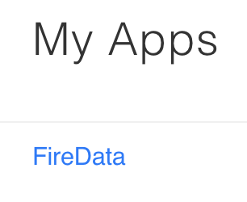
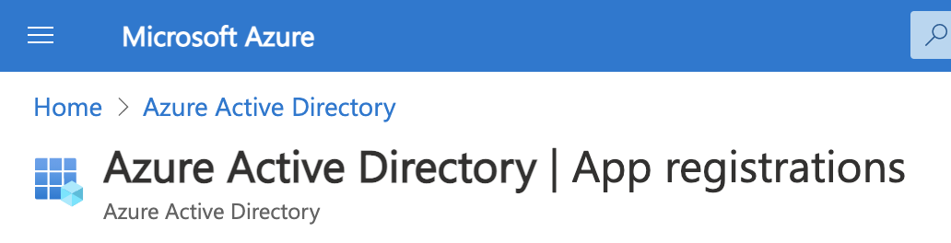
It’s ok to be selective!
Looks easy, but each requires registering an app and comes with their own client id & secret
($100/year)

Slide 7
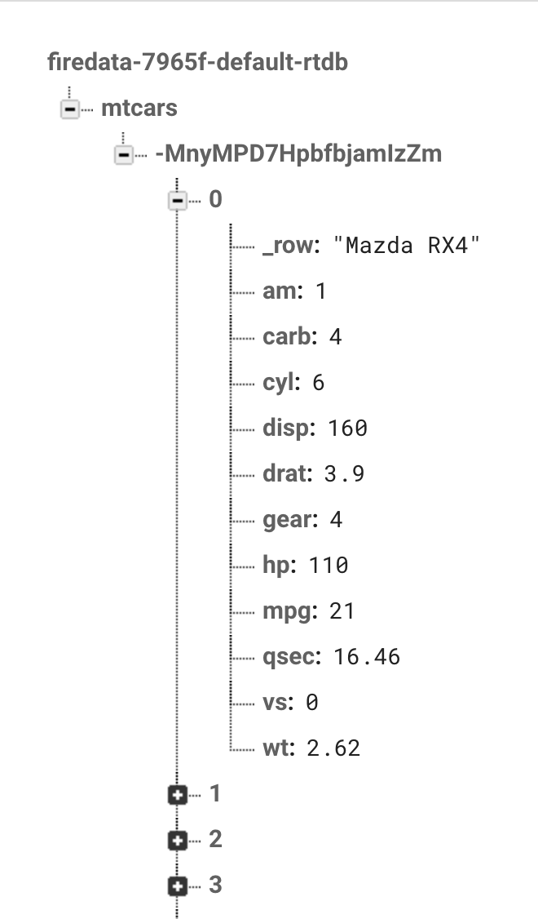
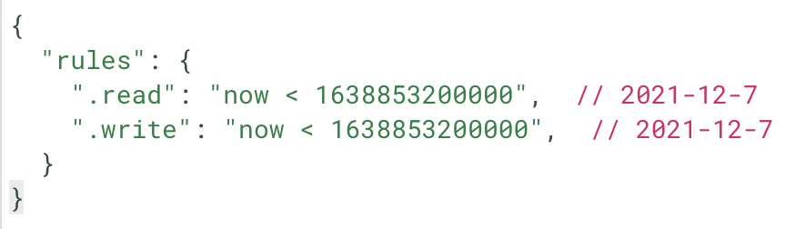
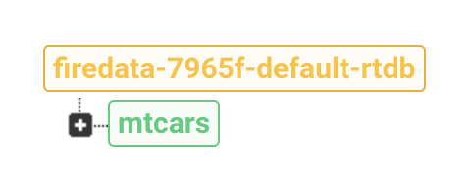
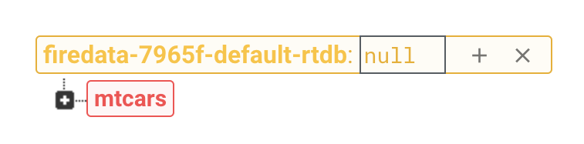
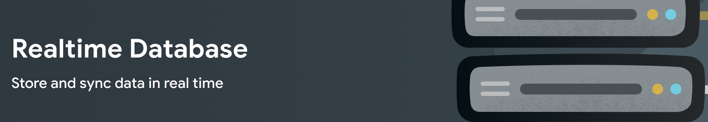
FireData — Realtime Database
Create — Read — Update — Delete
Document database (NoSQL) with flexible security rules
Color coded updates in realtime
Green – Create
Yellow – Update
Red - Delete
C - upload - Creates node with new random id sub; returns path
R - download – Reads node; returns JSON (jsonlite)
U – put/patch
D – delete
Free 1 GB, 1 GB dl/month
Auth disabled, else token arg req

Slide 8
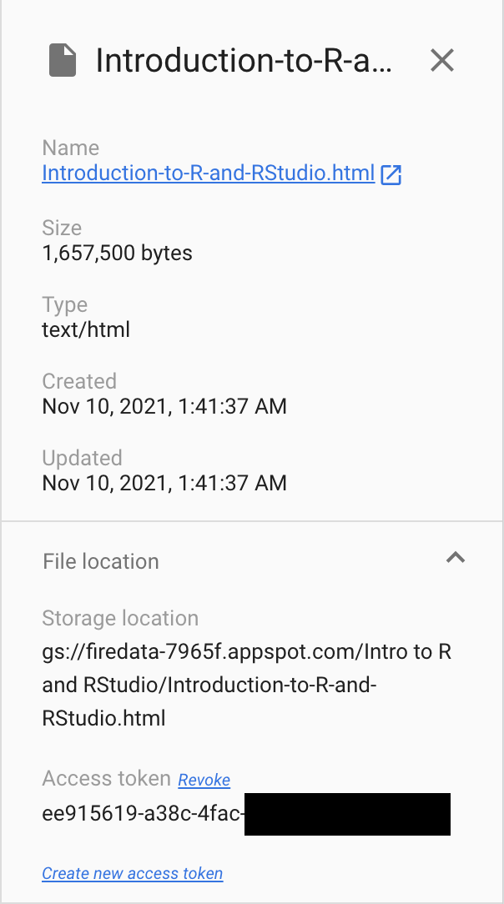
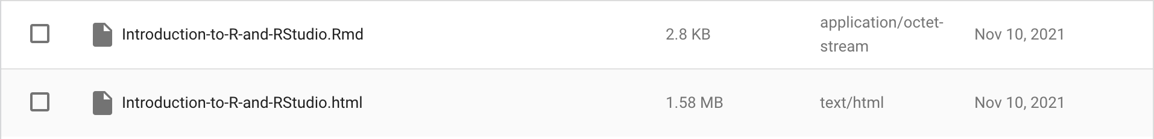
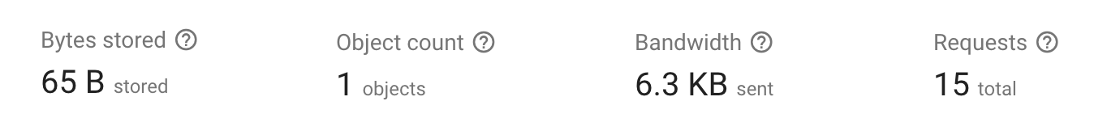

FireData — Cloud Storage
Create — Read — Delete
Less feature rich than AWS S3 buckets, but integrates with authentication
Requires Google auth, localhost redirect won’t work – google_devstorage_read_only/write
C – upload_storage, upload_folder, deploy_rmarkdown
R – get_storage, list_storage
D – delete_storage
Free 5 GB, 1 GB dl/day

Slide 9
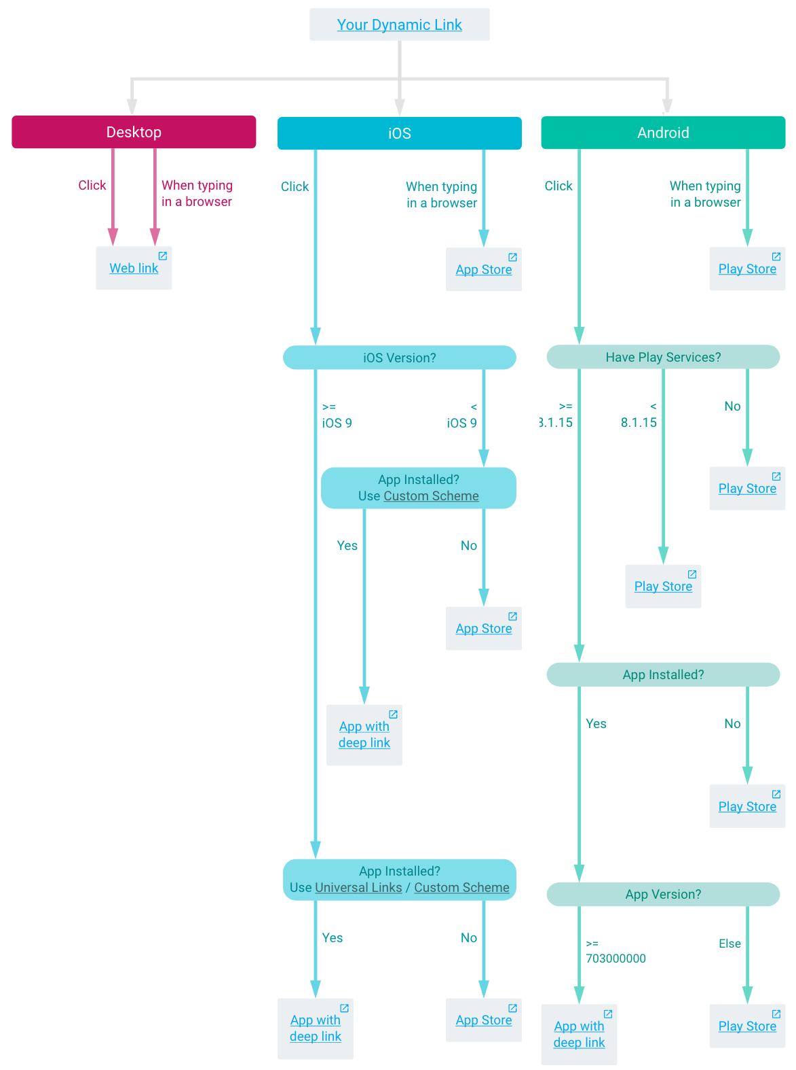
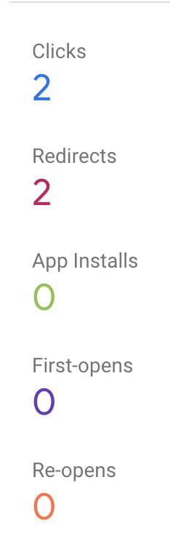
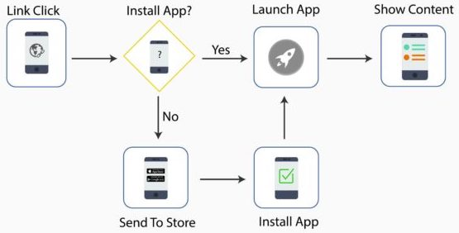
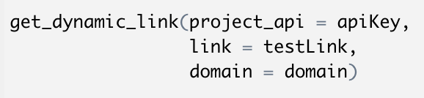
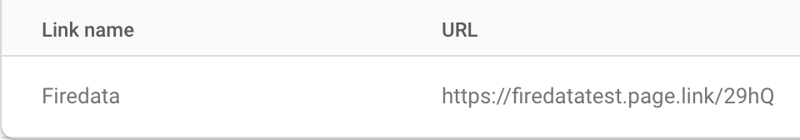
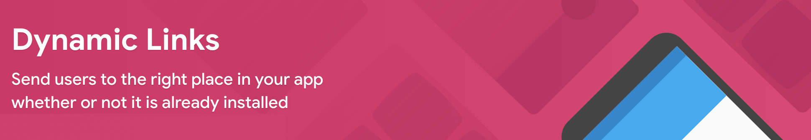
FireData — Dynamic Links
Short links
Redirect links that can route to app store and/or deeplink
Programmatic API short links meant for user-to-user sharing
Tracked links are created from the dashboard
Custom domains

Slide 10
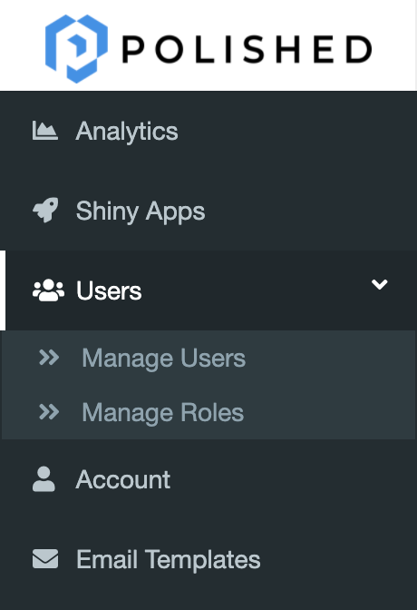
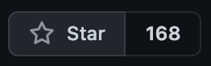

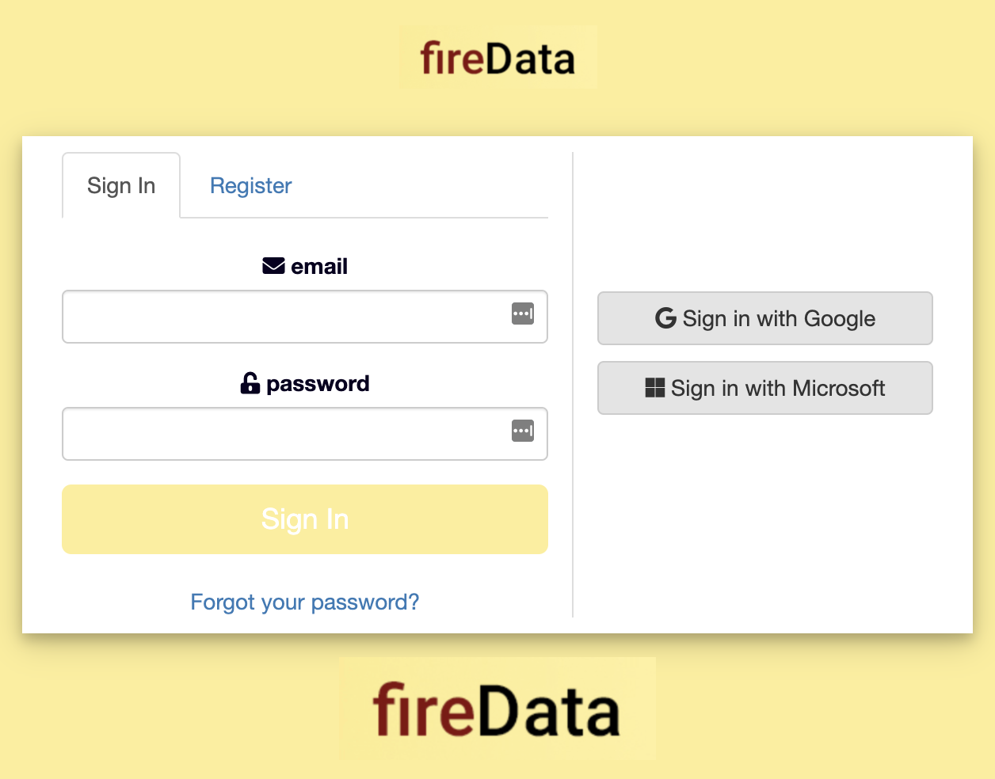
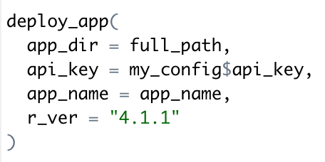
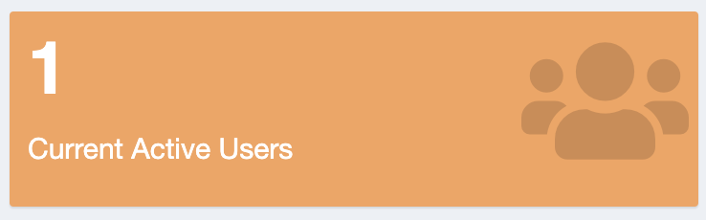



Bonus: R-First SaaS
Polished by Tychobra
Open-source white label solution with many templates
Authentication (SSOs use Firebase) & custom Hosting (Rocker)
Excellent support (shout-out to CEO Andy Merlino for the help)
Free month, $10/app/month for 2 GiB

Slide 11
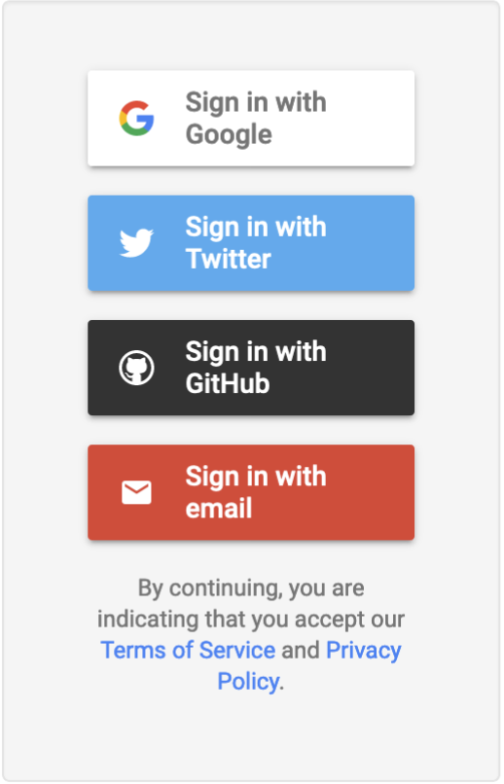
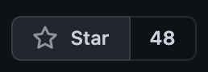
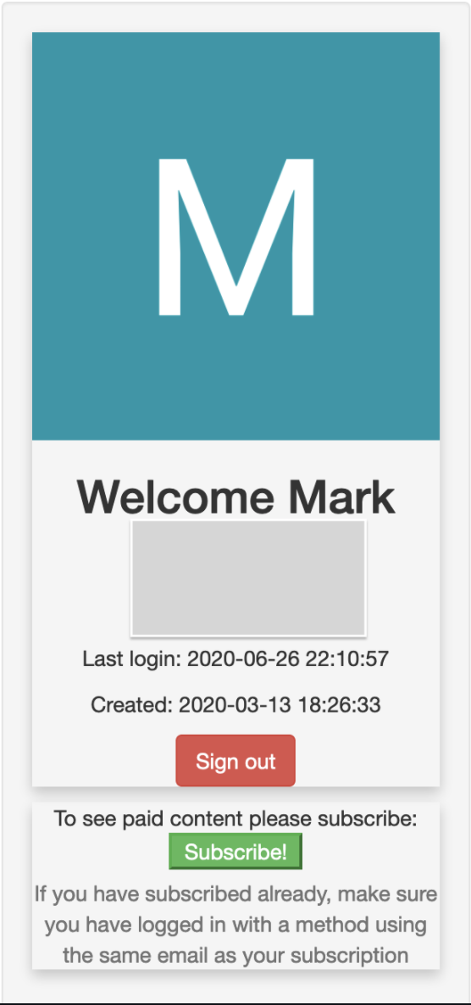
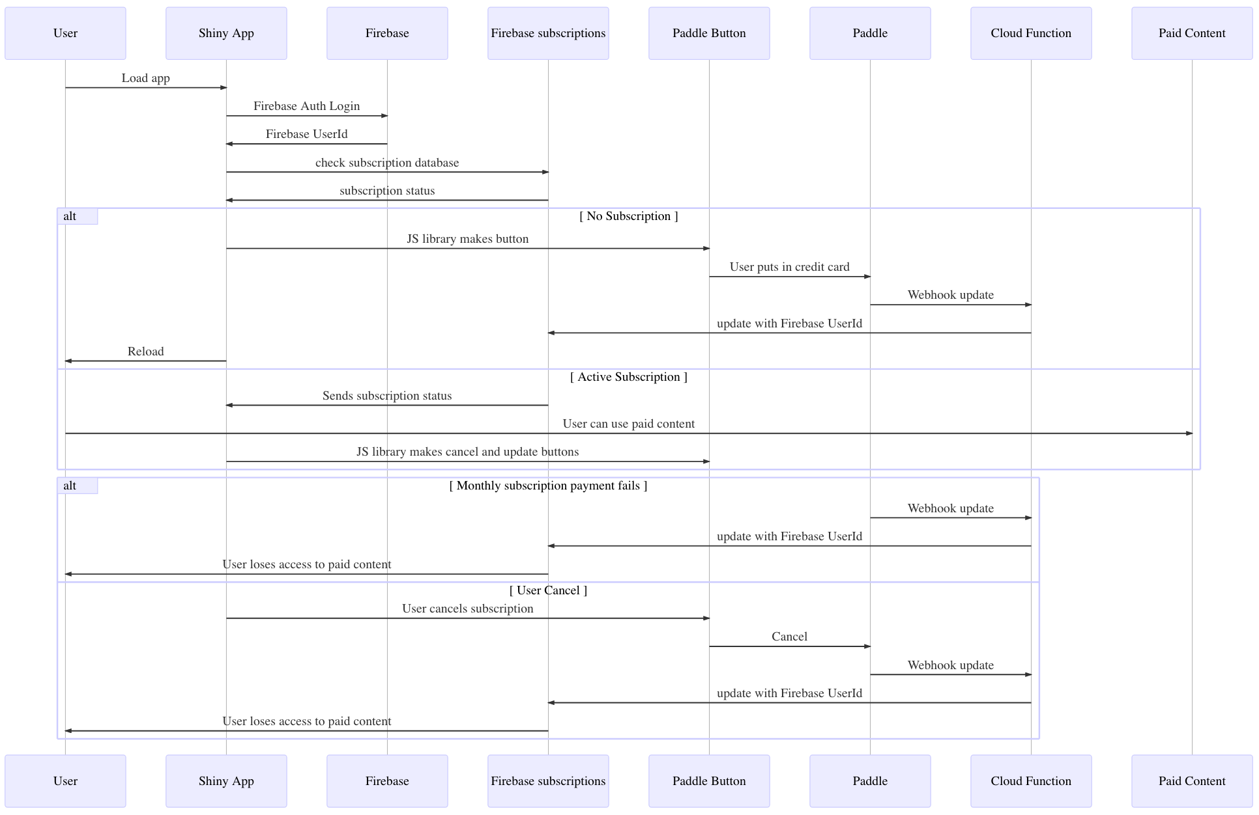
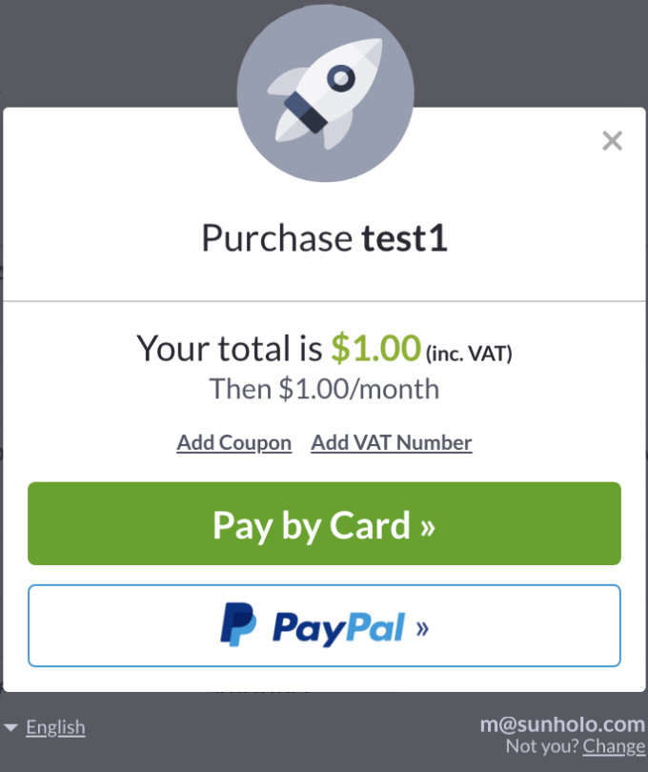
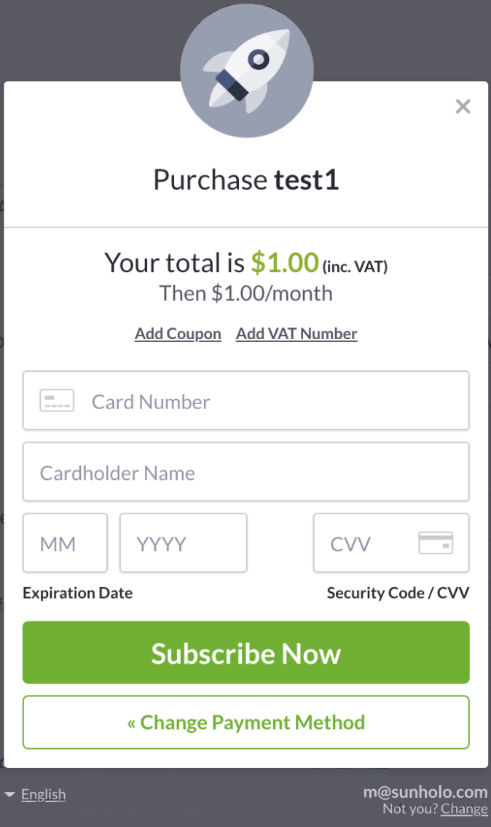
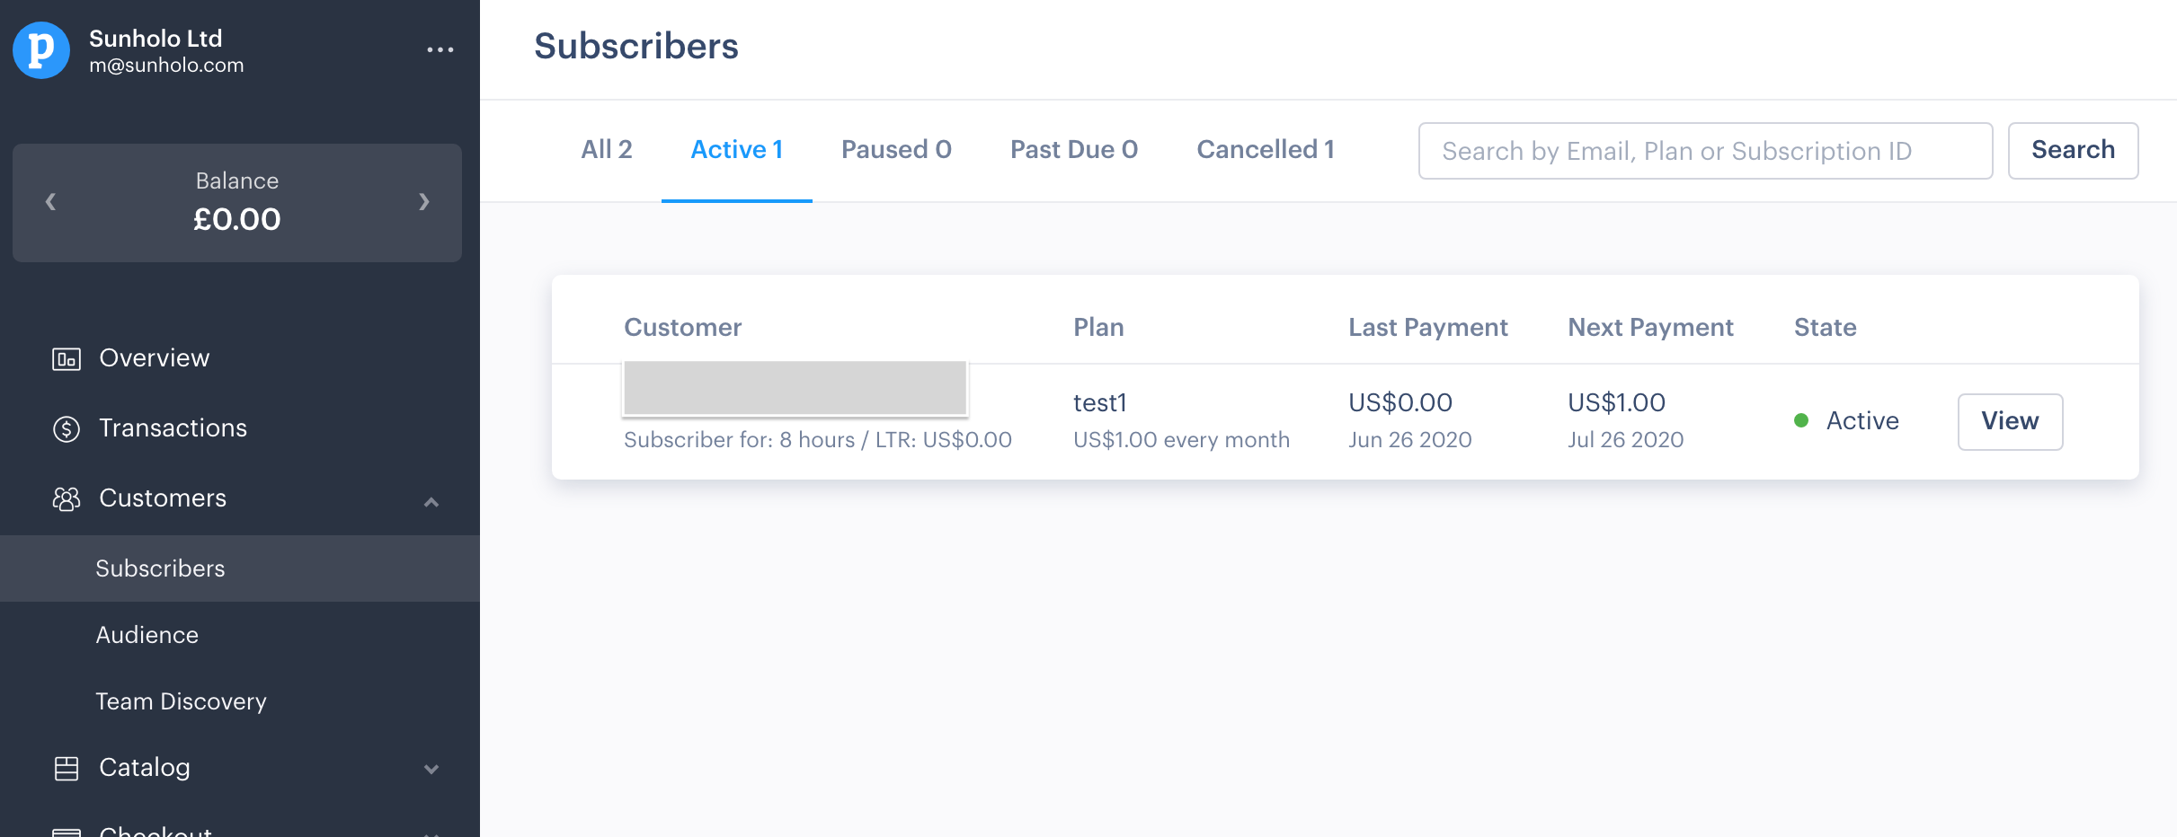
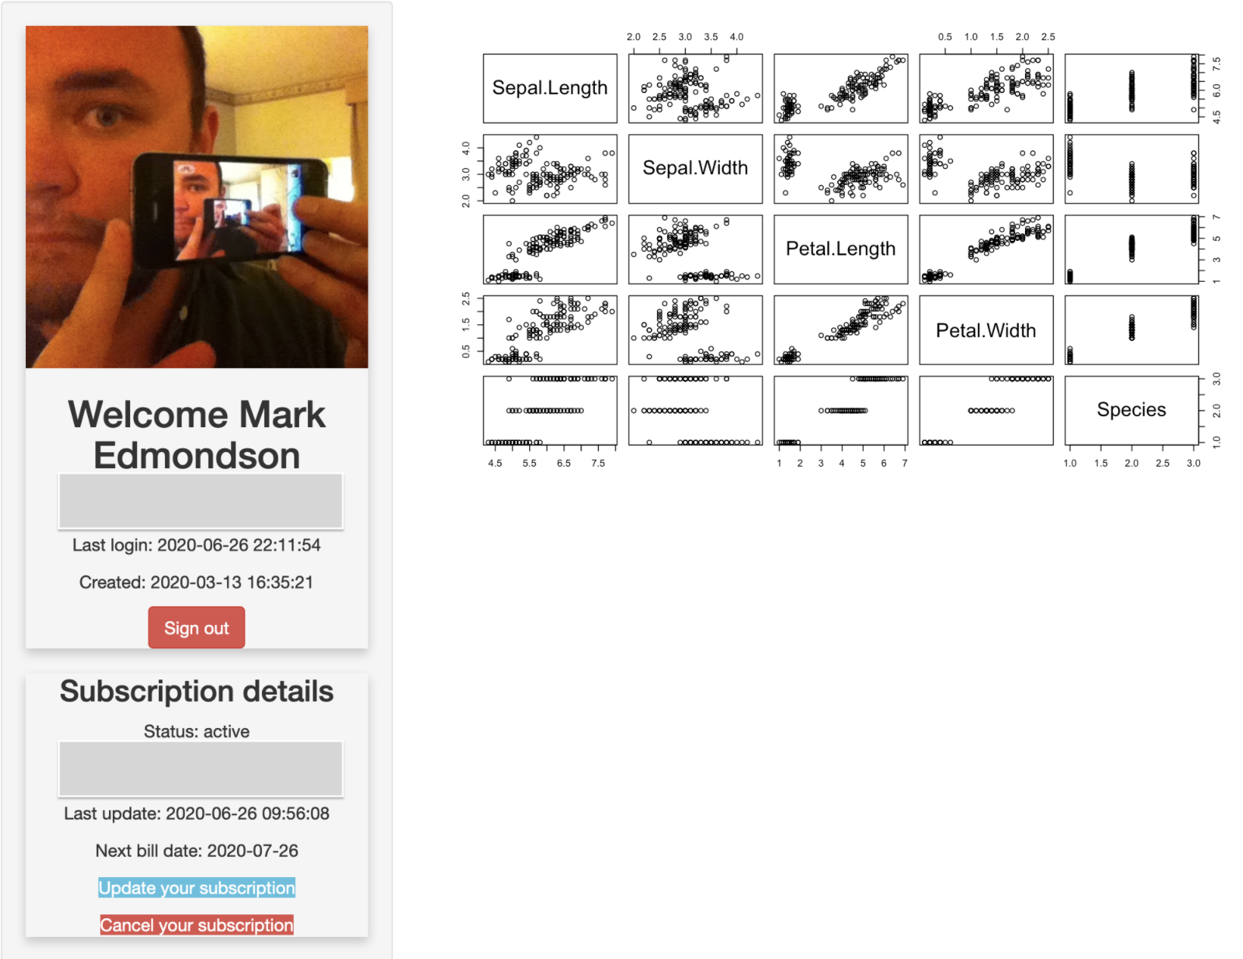
Bonus: Authentication Use Case
Bootstrapping paid Shiny applications with Firebase & Paddle by Mark Edmondson (https://github.com/MarkEdmondson1234/Shiny-R-SaaS/)

Slide 12
References
https://blog.back4app.com/backend-as-a-service-baas/#Business_reasons_to_use_a_BaaS
https://blog.back4app.com/firebase-alternatives/
https://paulspen.de/fireData/
https://github.com/paulsp94/fireData
https://github.com/Kohze/fireData
https://github.com/JohnCoene/firebase
https://polished.tech/
https://github.com/MarkEdmondson1234/Shiny-R-SaaS/
https://stackoverflow.com/questions/63123172/getting-error-when-trying-to-write-to-firebase-firestore-with-r
https://stackoverflow.com/questions/45228338/firebase-database-data-to-r

